Slide 1

General Assembly
In-person meeting, October 8th 2026

Slide 2


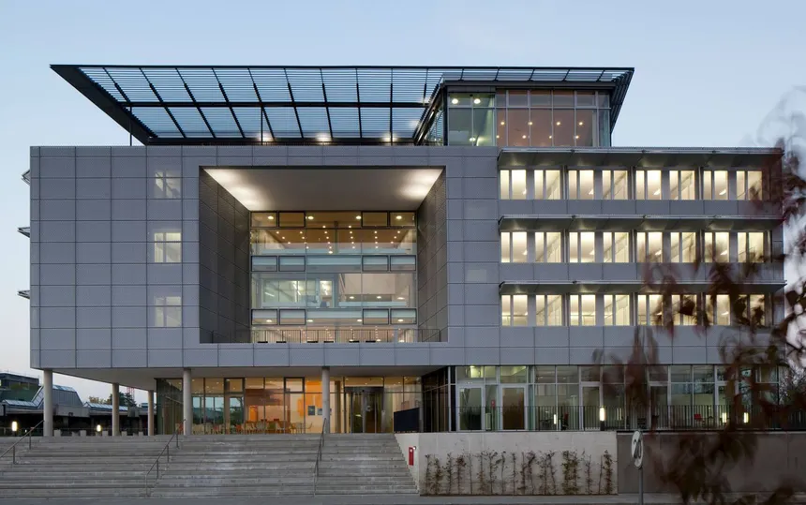










Annual Meeting 2026
Institute for Advanced Study
Lichtenbergstraße 2 a, 85748 Garching
Thursday, October 8th
Time | Agenda
11:30 - 12:30 | Reception & Lunch
12:30 - 13:00 | Welcome (S. Glaser, F. Schilling)
13:00 - 14:30 | Status Reports & Milestones, Work Package 1 & 2 (I. Schwartz, V. Rasche)
14:30 - 16:00 | Status Reports & Milestones, Work Package 3 & 4 (F. Schilling, V. Guyot)
16:00 - 16:30 | Group Picture / Coffee Break
16:30 - 16:45 | Approval of the 2-Year QuE-MRT project extension (I. Schwartz)
16:45 - 17:30 | Kickoff of the project extension (TBA)
17:30 - 17:45 | DLR New Project Lead Partner, Introduction (TBA)
17.45 - 18:00 | Further Requests, Miscellaneous, Meeting End (C. Müller, S. Glaser)
19:00 - Open End | Dinner & Social Event: .

Slide 4
AP X.Y: Scientific Highlight
Name

Slide 5
AP X.Y: Scientific Highlight

